Slide 1
Python Programming - II
-By Nimesh Kumar Dagur, CDAC, India

Slide 2
Python Strings
Strings in Python are identified as a contiguous set of characters in between quotation marks.
Python allows for either pairs of single or double quotes.
Subsets of strings can be taken using the slice operator ( [ ] and [ : ] ) with indexes starting at 0 in the beginning of the string and working their way from -1 at the end.
The plus ( + ) sign is the string concatenation operator and the asterisk ( * ) is the repetition operator

Slide 3
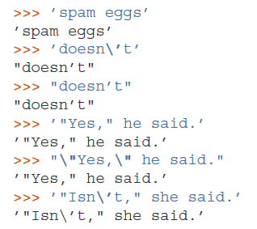
Working With Strings
Besides numbers, Python can also manipulate strings, which can be expressed in several ways.
They can be enclosed in single quotes or double quotes:

Slide 4
Working With Strings
String literals can span multiple lines in several ways.
Continuation lines can be used, with a backslash as the last character on the line indicating that the next line is a logical continuation of the line:
Note that newlines still need to be embedded in the string using \n; the newline following the trailing backslash is discarded.
strings can be surrounded in a pair of matching triple-quotes: """ or ”’.
End of lines do not need to be escaped when using triple-quotes, but they will be included in the string.

Slide 5
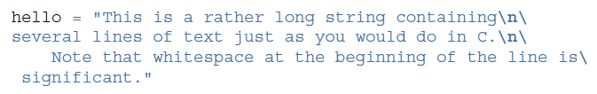

Working With Strings

Slide 6
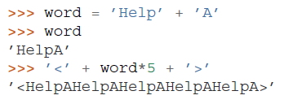
Working With Strings
Strings can be concatenated with the + operator, and repeated with *:

Slide 7
Working With Strings
Two string literals next to each other are automatically concatenated;
the first line above could also have been written
word = ’Help’ ’A’;
this only works with two literals, not with arbitrary string expressions:

Slide 8
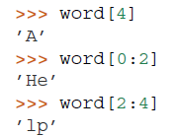
Working With Strings
Strings can be subscripted (indexed); like in C, the first character of a string has subscript (index) 0.
substrings can be specified with the slice notation: two indices separated by a colon.
word=“HelpA”

Slide 9
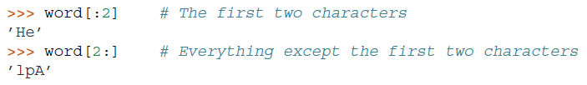
Working With Strings
Slice indices have useful defaults; an omitted first index defaults to zero, an omitted second index defaults to the size of the string being sliced.

Slide 10


Working With Strings
creating a new string with the combined content is easy and efficient:
Here’s a useful invariant of slice operations:
s[:i] + s[i:] equals s.

Slide 11
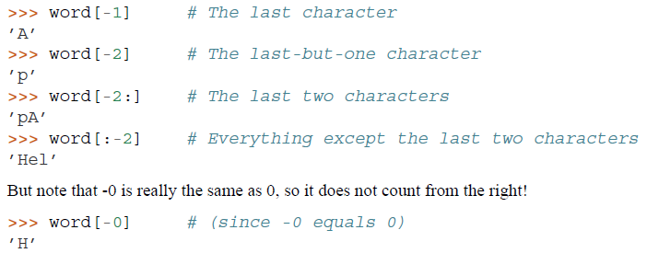
Working With Strings
Indices may be negative numbers, to start counting from the right.

Slide 12

Working With Strings
The built-in function len() returns the length of a string:

Slide 13
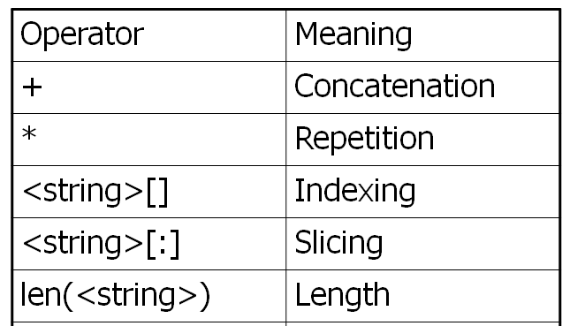
String Data Type

Slide 14
String Formatting Operator
One of Python's coolest features is the string format operator %.
This operator is unique to strings and makes up for the pack of having functions from C's printf() family
(
)

Slide 15
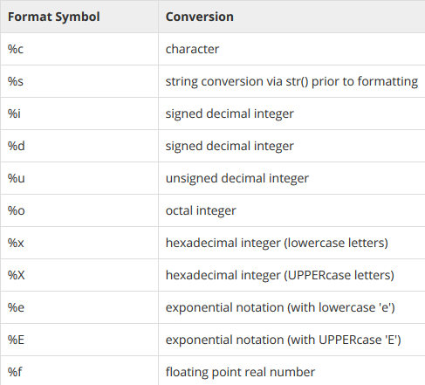
String Formatting Operator
List of set of symbols which can be used along with %

Slide 16
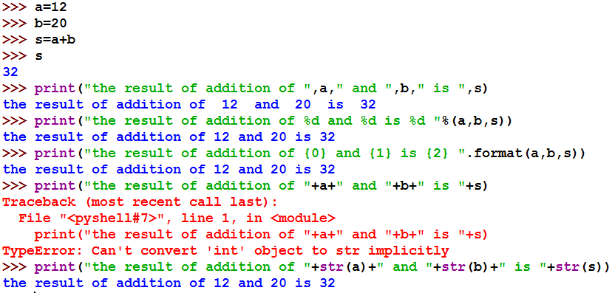
String Formatting : Example(s)

Slide 17

Built-in String Methods
capitalize(): It returns a copy of the string with only its first character capitalized.
str.capitalize ( )
(
)

Slide 18

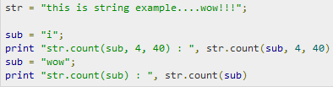

Built-in String Methods
count(): The method count() returns the number of occurrences of substring sub in the range [start, end].

Slide 19

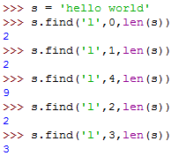
Built-in String Methods
find(): It determines if string str occurs in string, or in a substring of string if starting index beg and ending index end are given.
,
Index if found and -1 otherwise.

Slide 20


Built-in String Methods
lower(): The method lower() returns a copy of the string in which all case-based characters have been lowercased.

Slide 21

Built-in String Methods
upper() :The method upper() returns a copy of the string in which all case-based characters have been uppercased.
swapcase(): The method swapcase() returns a copy of the string in which all the case-based characters have had their case swapped.
title(): The method title() returns a copy of the string in which first characters of all the words are capitalized.
replace() : The method replace() returns a copy of the string in which the occurrences of old have been replaced with new, optionally restricting the number of replacements to max.

Slide 22
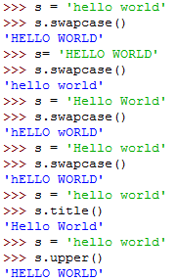
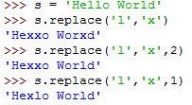

Slide 23
Data Type Conversion
Sometimes, you may need to perform conversions between the built-in types.
To convert between types, you simply use the type name as a function.
There are several built-in functions to perform conversion from one data type to another.
These functions return a new object representing the converted value.

Slide 24
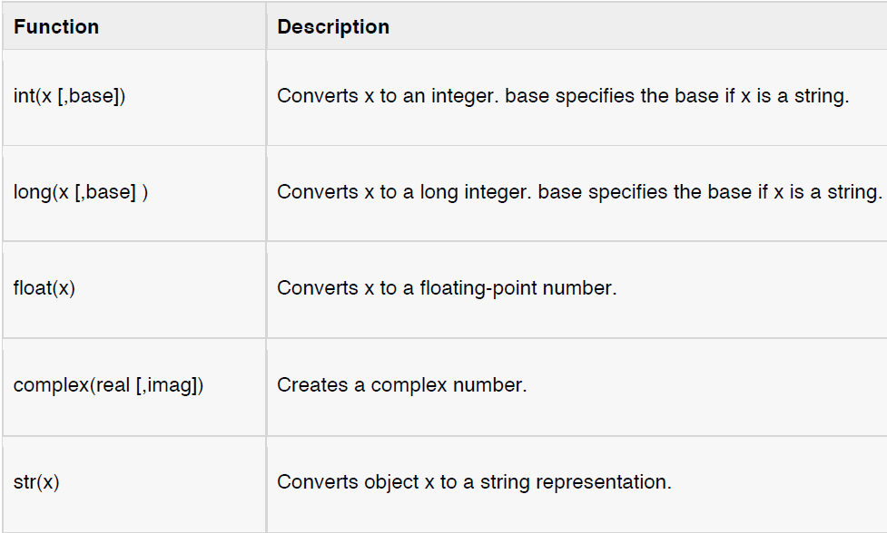
Data Type Conversion

Slide 25
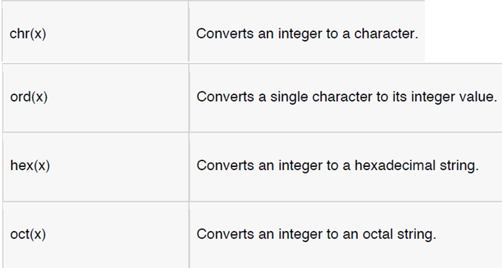
Data Type Conversion

Slide 26

Python Operators
Operators are special symbols in Python that carry out arithmetic or logical computation.
The value that the operator operates on is called the operand.

Slide 27
Type of operators in Python
Python has a number of operators which are classified below:
Arithmetic operators
Comparison (Relational) operators
Logical (Boolean) operators
Assignment operators
Special operators: Identity operators & membership operator

Slide 28
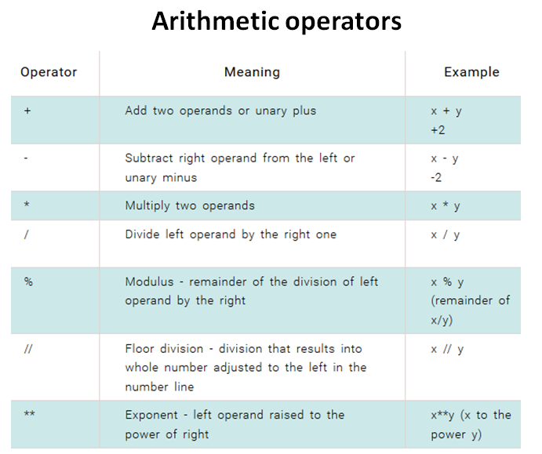

Slide 29
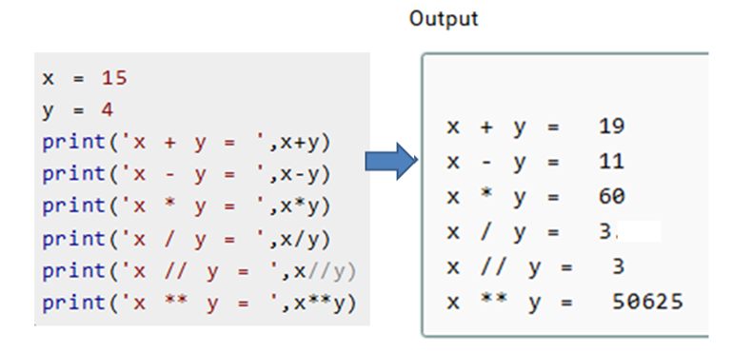
Arithmetic operators
In Python 3.x
3.75

Slide 30
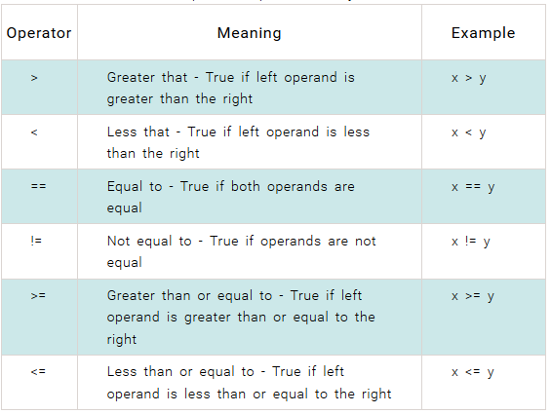
Comparison operators
Comparison operators are used to compare values.
It either returns True or False according to the condition

Slide 31
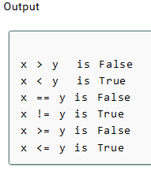
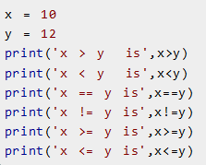
Comparison operators

Slide 32
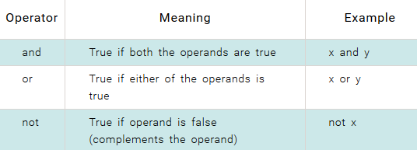
Logical operators
True, False : True and False are truth values in Python. They are the results of comparison operations or logical (Boolean) operations in Python.
True and False in python is same as 1 and 0

Slide 33
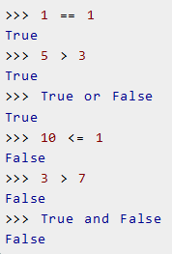
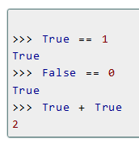
Logical operators

Slide 34
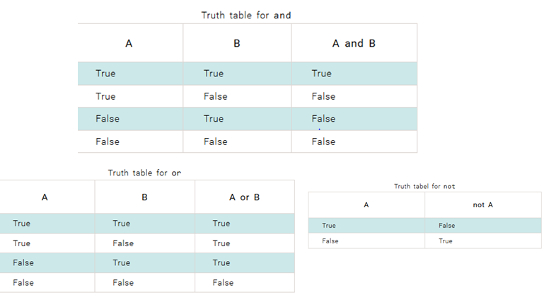
Logical operators

Slide 35
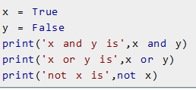

Logical operators

Slide 36
Assignment operators
Assignment operators are used in Python to assign values to variables.
a = 5 is a simple assignment operator that assigns the value 5 on the right to the variable a on the left.
There are various compound operators in Python like a += 5 that adds to the variable and later assigns the same. It is equivalent to a = a + 5.

Slide 37
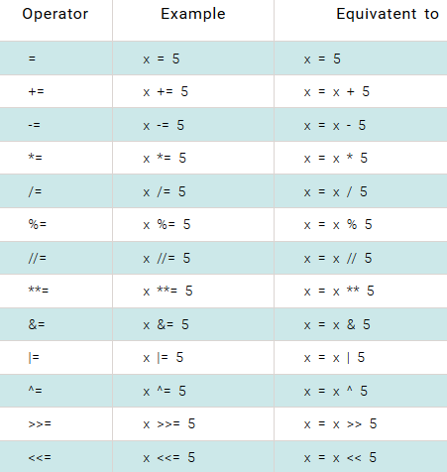
Assignment operators

Slide 38
Special operators
Python language offers some special type of operators like the identity operator or the membership operator.

Slide 39
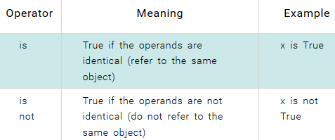
Identity operators
is and is not are the identity operators in Python.
They are used to check if two values (or variables) are located on the same part of the memory.
Two variables that are equal does not imply that they are identical.

Slide 40
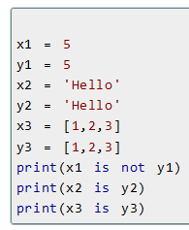

Identity operators

Slide 41
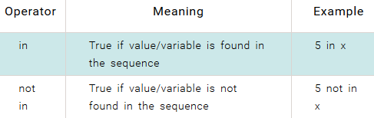
Membership operators
in and not in are the membership operators in Python.
They are used to test whether a value or variable is found in a sequence (string, list, tuple and dictionary).
In a dictionary we can only test for presence of key, not the value.

Slide 42
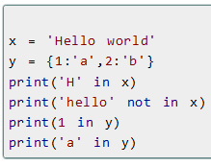

Membership operators

Slide 43
Order Of Operation
First level of precedence: top to bottom
Second level of precedence
If there are multiple operations that are on the same level then precedence goes from left to right.
() | Brackets (inner before outer)
** | Exponent
*, /, % | Multiplication, division, modulo
+, - | Addition, subtraction
Almost all operators except the exponent(**) support the Left-to-right Associativity.

Slide 44
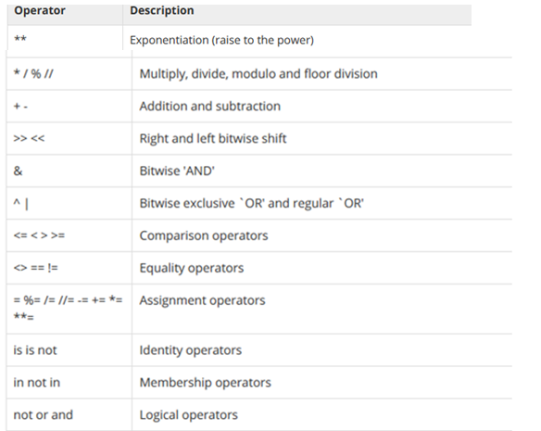
Python Operators Precedence
Operators from highest precedence to lowest
Highest
lowest

Slide 45
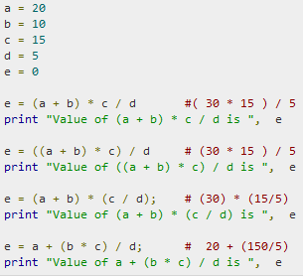
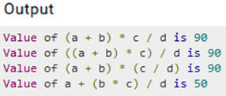
Python Operators Precedence

Slide 46
Bit-wise operators
AND(&): bits(0 and 1) are set to 1 if both the inputs are 1 otherwise 0.
And (&)
Input1 | input2 | Output
0 | 0 | 0
0 | 1 | 0
1 | 0 | 0
1 | 1 | 1

Slide 47
Or(|): bits are set to 1 if both the inputs or any one of the input is 1.
Input1 | input2 | Output
0 | 0 | 0
0 | 1 | 1
1 | 0 | 1
1 | 1 | 1

Slide 48
XOR(^):bits are set to 1 if any one of the input is 1 otherwise 0.
Input1 | input2 | Output
0 | 0 | 0
0 | 1 | 1
1 | 0 | 1
1 | 1 | 0

Slide 49
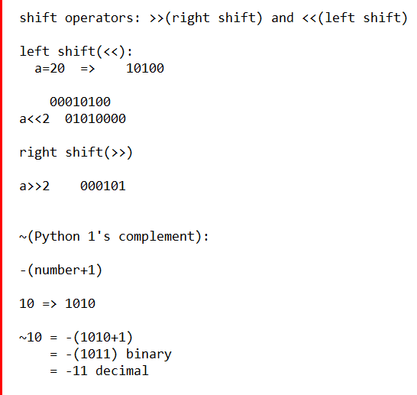

Slide 50

Python Lists:
The most basic data structure in Python is the sequence.
Each element of a sequence is assigned a number - its position or index.
The first index is zero, the second index is one, and so forth.
Most common sequences are lists and tuples.
There are certain things you can do with all sequence types.
These operations include indexing, slicing, adding, multiplying, and checking for membership.
In addition, Python has built-in functions for finding the length of a sequence and for finding its largest and smallest elements.

Slide 51
Python Lists:
Lists are the most versatile of Python's compound data types.
A list contains items separated by commas and enclosed within square brackets ([]).
To some extent, lists are similar to arrays in C. One difference between them is that all the items belonging to a list can be of different data type.
The values stored in a list can be accessed using the slice operator ( [ ] and [ : ] ) with indexes starting at 0 in the beginning of the list and working their way to end -1.
The plus ( + ) sign is the list concatenation operator, and the asterisk ( * ) is the repetition operator.
A list can even have another list as an item. These are called nested list.

Slide 52
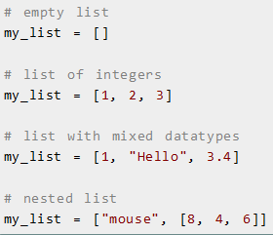

Slide 53
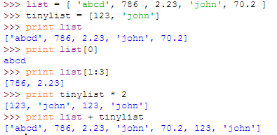
Example

Slide 54


Accessing Values in Lists
To access values in lists, use the square brackets for slicing along with the index or indices to obtain value available at that index

Slide 55
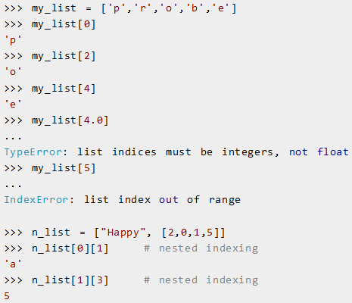
Accessing Values in Lists

Slide 56


Slide 57
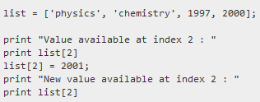

Updating Lists
You can update single or multiple elements of lists by giving the slice on the left-hand side of the assignment operator, and you can add to elements in a list with the append() method.
1997
2001

Slide 58

Python List append() Method
The method append() appends a passed obj into the existing list.

Slide 59


Delete List Elements
To remove a list element, you can use either the del statement if you know exactly which element(s) you are deleting or the remove() method if you do not know

Slide 60
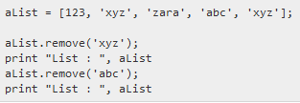

Python List remove() Method

Slide 61
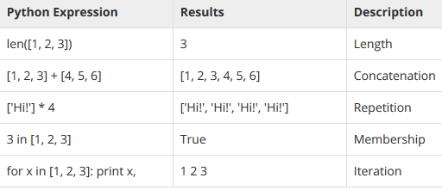
Basic List Operations
Lists respond to the + and * operators much like strings; they mean concatenation and repetition here too, except that the result is a new list, not a string.

Slide 62

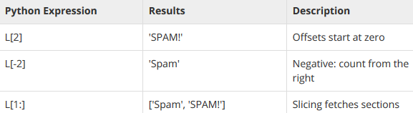
Indexing & Slicing
Because lists are sequences, indexing and slicing work the same way for lists as they do for strings.

Slide 63


Built-in List Functions & Methods:
len(): The method len() returns the number of elements in the list.

Slide 64


Built-in List Functions & Methods:
max(): The method max returns the elements from the list with maximum value.
Note: in Python3.x version max is used only for same kind of values at a time

Slide 65


Built-in List Functions & Methods:
min() : The method min() returns the elements from the list with minimum value.
Note: in Python3.x version min is used only for same kind of values at a time

Slide 66


Built-in List Functions & Methods:
count() : The method count() returns count of how many times obj occurs in list.
Syntax:

Slide 67

Built-in List Functions & Methods:
extend() : The method extend() appends the contents of seq to list.
seq is the list of elements.

Slide 68
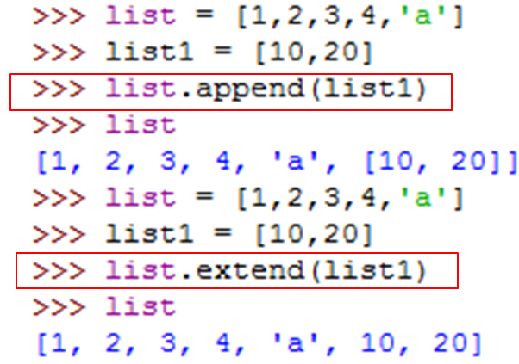

Slide 69


Built-in List Functions & Methods:
insert() : The method insert() inserts object obj into list at offset index.
Syntax:

Slide 70


Built-in List Functions & Methods:
index() : The method index() returns the lowest index in list that obj appears

Slide 71
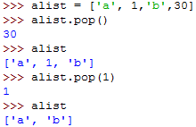
Built-in List Functions & Methods:
pop(): pop([i]) return and remove the item at position i (last item if i is not provided)

Slide 72
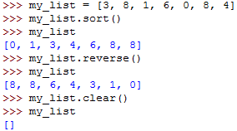
Built-in List Functions & Methods:
sort(): Sort items in a list in ascending order
reverse(): Reverse the order of items in a list
clear(): Remove all items and empty the list

